Slide 1
Elastic Search

Slide 2
Agenda
Introduction to Elasticsearch
Elastisearch Features
Elastisearch Architecture
Using Elasticsearch
a. Steps To create an OpenSearch Service domain using the console
b. Using a Proxy to Access OpenSearch Service from Dashboards
c. Configuring OpenSearch Dashboards to use a WMS map server
d. Connecting a local Dashboards server to OpenSearch Service
Visualizing Elasticsearch Data

Slide 3
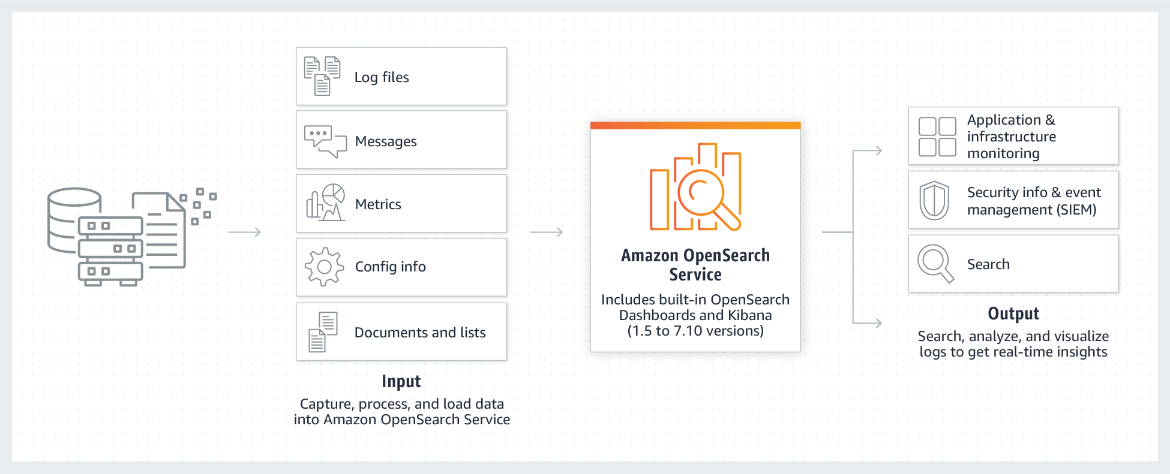
Introduction to Elasticsearch
The Amazon Elasticsearch Service is a fully managed service that makes the Elasticsearch open-source search and analytics engine easy to deploy, operate, and scale.
Amazon Elasticsearch Service has been replaced with Amazon OpenSearch Service, which supports both OpenSearch and old Elasticsearch OSS (up to 7.10, the final open-source version of the software).
Amazon OpenSearch Service is a managed service that makes it easy to deploy, operate, and scale OpenSearch clusters in the AWS Cloud.
OpenSearch is a free and open-source search and analytics engine that may be used for log analysis, real-time application monitoring, and clickstream analysis, among other things.
Credit: https://aws.amazon.com/opensearch-service/
Notes:
Reference for contents: https://docs.aws.amazon.com/opensearch-service/latest/developerguide/what-is.html
More Explanation:
Find what you need quickly by searching and analyzing your unstructured and semi-structured data.
Automated provisioning, software installation, patching, storage tiering, and other tasks can help you save time and money.
Machine learning (ML) may be used to detect anomalies in real time, autotune clusters, and customise search results.

Slide 4
Elasticsearch Features
Setup and configuration
Scalable
Stability
In-place upgrades
Event monitoring and alerting
Support for multiple query languages
Integration with open-source tools
Security
Hot Storage
UltraWarm storage
Cold storage
Notes:
Reference for contents:
https://aws.amazon.com/opensearch-service/features/
https://docs.aws.amazon.com/opensearch-service/latest/developerguide/what-is.html
More Explanation:
Setup and configuration: The Amazon OpenSearch Service is simple to use.
Scalable: Numerous configurations of CPU, memory, and storage capacity known as instance types, including cost-effective Graviton instances Up to 3 PB of attached storage
Stability: Node allocation across two or three Availability Zones in the same AWS Region, known as Multi-AZ
In-place upgrades: Using in-place version upgrades, Amazon OpenSearch Service makes it simple to upgrade your OpenSearch and Elasticsearch clusters (up to version 7.10) to newer versions with no downtime.
Event monitoring and alerting: The Amazon OpenSearch Service includes built-in event monitoring and alerting, allowing you to keep track of the data in your cluster and deliver notifications automatically depending on pre-defined thresholds.
Support for multiple query languages: OpenSearch query domain-specific language (DSL) knowledge isn't required with Amazon OpenSearch Service.
Integration with open-source tools: Amazon OpenSearch Service includes built-in OpenSearch Dashboards and Kibana (Elasticsearch 7.10 and earlier) as well as Logstash integration, allowing you to ingest and display your data using the open-source tools you prefer.
Security: You can securely connect your applications to your managed Elasticsearch (version 7.10 and older) or OpenSearch environment from your Amazon Virtual Private Cloud (VPC) or the public Internet using Amazon OpenSearch Service, configuring network access using VPC security groups or IP-based access policies.
Hot storage: enables for quick access to frequently used data.
UltraWarm: is a warm storage tier that works in tandem with Amazon OpenSearch Service's hot storage layer to provide less expensive storage for older and less-frequently visited data while still allowing for interactive querying.
Cold storage: for Amazon OpenSearch Service is the cheapest storage option, allowing you to keep infrequently accessed data in Amazon S3 and only pay for computation when you need it.

Slide 5
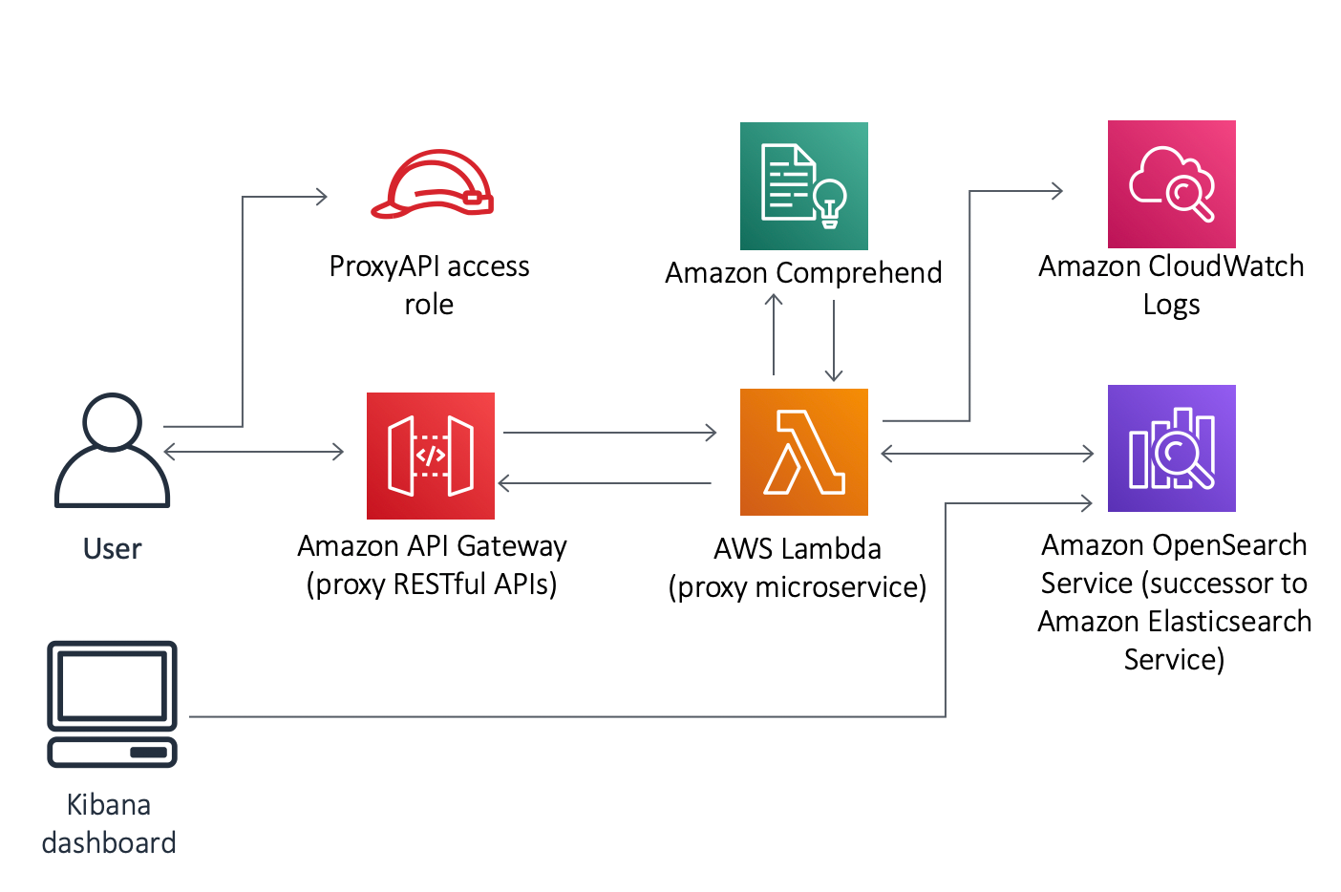
Elasticsearch Architecture
To execute the proxy microservice (AWS Lambda function), the AWS CloudFormation template creates an Amazon API Gateway.
The business logic for managing preprocessing configuration, native indexing, and other native search capabilities is provided by the microservice (AWS Lambda function).
Amazon Comprehend for text analysis, Amazon CloudWatch Logs for logging and monitoring, and Amazon OpenSearch Service for indexing documentation are all used by the microservice.
The proxy microservice transmits the request to Amazon Comprehend for text analysis when the API receives an authorized request.
The data is indexed by Amazon OpenSearch Service, which also transmits logs and metrics to CloudWatch.
Credit: https://docs.aws.amazon.com/solutions/latest/text-analysis-with-amazon-opensearch-service-and-amazon-comprehend/architecture-overview.html
Notes:
Reference for contents:
https://docs.aws.amazon.com/solutions/latest/text-analysis-with-amazon-opensearch-service-and-amazon-comprehend/architecture-overview.html
https://docs.aws.amazon.com/solutions/latest/text-analysis-with-amazon-opensearch-service-and-amazon-comprehend/text-analysis-with-amazon-opensearch-service-and-amazon-comprehend.pdf#architecture-overview
More Explanation:
You can visualize the indexed data on the solution’s pre-configured Kibana dashboard.
Amazon API Gateway: The Amazon API Gateway service is a fully managed service that allows developers to easily construct, publish, maintain, monitor, and protect APIs at any size. APIs allow applications to access data, business logic, and functionality from your backend services by acting as a "front door.“
AWS Lambda: AWS Lambda is a serverless, event-driven computing solution that allows you to run code for almost any form of application or backend service without having to provision or manage servers. Over 200 AWS services and software as a service (SaaS) apps can trigger Lambda, and you only pay for what you use.
Amazon Comprehend: Amazon Comprehend is a natural-language processing (NLP) service that employs machine learning to extract useful insights and connections from text.
Amazon CloudWatch Logs: You can monitor, store, and access log files from Amazon Elastic Compute Cloud (Amazon EC2) instances, AWS CloudTrail, Route 53, and other sources using Amazon CloudWatch Logs. CloudWatch Logs is a service that allows you to consolidate logs from all of your systems, apps, and AWS services into a single, highly scalable service.

Slide 6
Using Elasticsearch
Steps To create an OpenSearch Service domain using the console
Step1: Go to https://aws.amazon.com and choose Sign-In to the Console.
Step2: Under Analytics, choose Amazon OpenSearch Service.
Step3: Choose Create domain.
Step4: Provide a name for the domain.
Step5: Ignore the Custom endpoint setting.
Step6: For the deployment type, choose Development and testing.
Step7: For Version, choose the latest version.
Step8: Under Data nodes, change the instance type to t3.small.search and keep the default value of three nodes.
Notes:
Reference for contents:
https://docs.aws.amazon.com/opensearch-service/latest/developerguide/gsgcreate-domain.html
More Explanation:
For Domain name, enter a domain name. The name must meet the following criteria:
Unique to your account and AWS Region
Starts with a lowercase letter
Contains between 3 and 28 characters
Contains only lowercase letters a-z, the numbers 0-9, and the hyphen (-)
If you want to use a custom endpoint rather than the standard one of https://search-mydomain-1a2a3a4a5a6a7a8a9a0a9a8a7a.us-east-1.es.amazonaws.com , choose Enable custom endpoint and provide a name and certificate.
Choose the option that best fits the purpose of your domain for Deployment type:
Multi-AZ and dedicated master nodes are used in production domains to increase availability.
A single Availability Zone is used by the development and testing domains.
Custom domains allow you to select from a wide range of setup choices.
Select the OpenSearch or traditional Elasticsearch OSS version to use for Version.
Fine-grained access control can be enabled or disabled.
Set IAM ARN as master user and give the ARN for an IAM role if you wish to use IAM for user management.
Choose Create master user and enter a user name and password if you wish to use the internal user database.
Choose an access policy or create your own for Domain access policy. You can configure a custom policy yourself or import one from another domain if you desire to do so.

Slide 7
Using Elasticsearch
Steps To create an OpenSearch Service domain using the console
Step9: For testing purposes, use a public access domain. Under Network, choose Public access.
Step10: In the fine-grained access control settings, choose Create master user. Provide a username and password.
Step11: For now, ignore the SAML authentication and Amazon Cognito authentication sections.
Step12: For Access policy, choose Only use fine-grained access control.
Step13: Ignore the rest of the settings and choose Create. New domains typically take 15–30 minutes to initialize but can take longer depending on the configuration. After your domain initializes, make note of its endpoint.
Notes:
Reference for contents:
https://docs.aws.amazon.com/opensearch-service/latest/developerguide/gsgcreate-domain.html
More Explanation:
1. For Domain name, enter a domain name. The name must meet the following criteria:
Unique to your account and AWS Region
Starts with a lowercase letter
Contains between 3 and 28 characters
Contains only lowercase letters a-z, the numbers 0-9, and the hyphen (-)
If you want to use a custom endpoint rather than the standard one of https://search-mydomain-1a2a3a4a5a6a7a8a9a0a9a8a7a.us-east-1.es.amazonaws.com , choose Enable custom endpoint and provide a name and certificate.
Choose the option that best fits the purpose of your domain for Deployment type:
Multi-AZ and dedicated master nodes are used in production domains to increase availability.
A single Availability Zone is used by the development and testing domains.
Custom domains allow you to select from a wide range of setup choices.
Select the OpenSearch or traditional Elasticsearch OSS version to use for Version.
Fine-grained access control can be enabled or disabled.
Set IAM ARN as master user and give the ARN for an IAM role if you wish to use IAM for user management.
Choose Create master user and enter a user name and password if you wish to use the internal user database.
Choose an access policy or create your own for Domain access policy. You can configure a custom policy yourself or import one from another domain if you desire to do so.

Slide 8
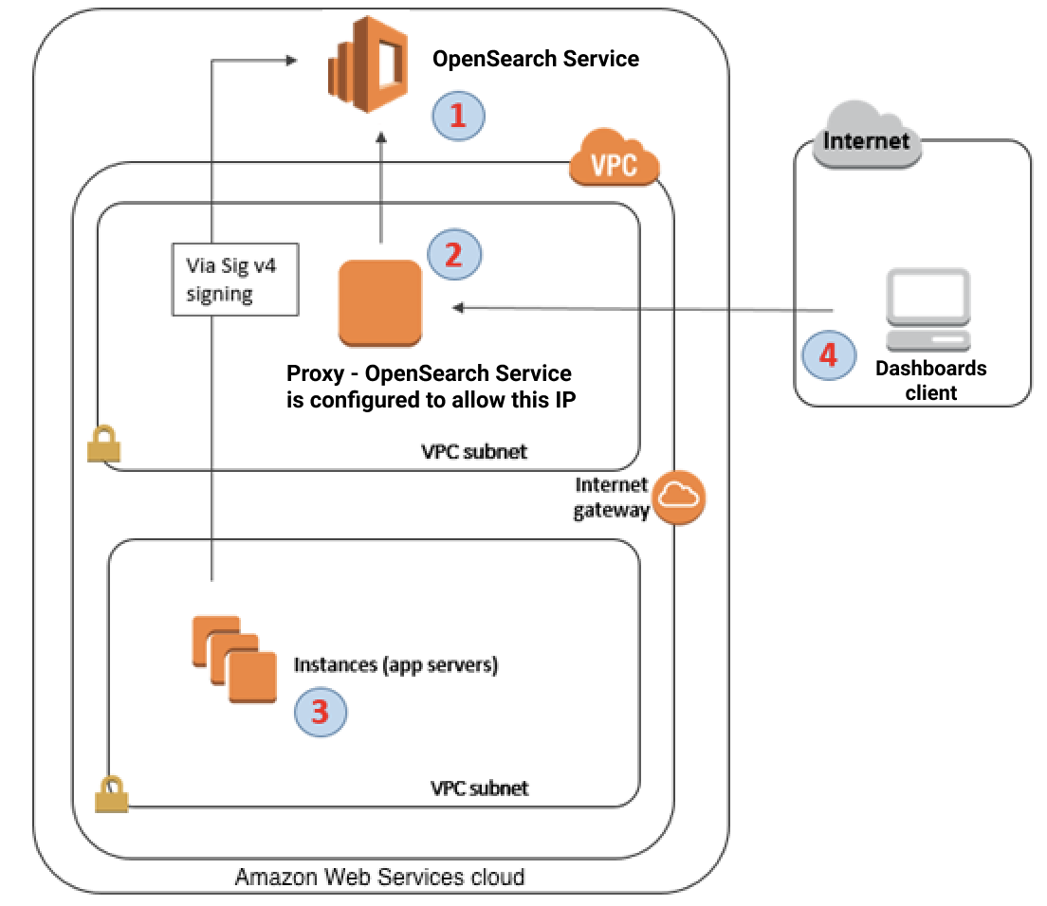
Using a Proxy to Access OpenSearch Service from Dashboards
This is the domain for your OpenSearch Service. This domain's access is controlled by IAM. The proxy server is accessible via an extra IP-based access policy.
This is the proxy server, which is hosted on Amazon EC2.
Other programmes can send authenticated requests to OpenSearch Service using the Signature Version 4 signing mechanism.
Through the proxy, OpenSearch Dashboards clients connect to your OpenSearch Service domain.
Credit: https://docs.aws.amazon.com/opensearch-service/latest/developerguide/dashboards.html
Notes:
Reference for contents:
https://docs.aws.amazon.com/opensearch-service/latest/developerguide/dashboards.html
More Explanation:
Requests originate from the user's IP address because Dashboards is a JavaScript application. Due to the large number of IP addresses that would need to be allowed in order for each user to have access to Dashboards, IP-based access restriction may be unfeasible. A proxy server can be placed between OpenSearch Dashboards and OpenSearch Service as a solution. Then you may create an IP-based access policy that only permits requests from the proxy's IP address. This is depicted in the diagram above.

Slide 9
Configuring OpenSearch Dashboards to use a WMS map server
Open Dashboards.
Choose Stack Management.
Choose Advanced Settings.
Locate visualization:tileMap:WMSdefaults.
Change enabled to true and url to the URL of a valid WMS map server:
{
"enabled": true,
"url": "wms-server-url",
"options": { "format": "image/png",
"transparent": true }
}
6. Save those changes
Notes:
Reference for contents:
https://docs.aws.amazon.com/opensearch-service/latest/developerguide/dashboards.html
More Explanation:
Change enabled to true and url to the URL of a valid WMS map server:
{
"enabled": true,
"url": "wms-server-url",
"options": {
"format": "image/png",
"transparent": true
}
}
Except for domains in the India and China Regions, the default installation of OpenSearch Dashboards for OpenSearch Service includes a map service. Up to ten zoom levels are supported by the map service.
You can configure Dashboards to use a separate Web Map Service (WMS) server for coordinate map representations regardless of your Region. Only the default map service is supported for region map visualisations.
You may need to reload Dashboards to apply the updated default value to visualisations. After you've opened a visualisation that you've saved, select Options. Choose Apply changes after verifying that WMS map server is enabled and WMS url contains your desired map server.

Slide 10
Connecting a local Dashboards server to OpenSearch Service
1. On your OpenSearch Service domain, create a user with the appropriate permissions:
a. In Dashboards, go to Security, Internal users, and choose Create internal user.
b. Provide a username and password and choose Create.
c. Go to Roles and select a role.
d. Select Mapped users and choose Manage mapping.
e. In Users, add your username and choose Map.
2. On your self-managed Dashboards OSS installation, download and install the relevant version of the OpenSearch security plugin.
3. On your local Dashboards server, open the config/opensearch_dashboards.yml file and add your OpenSearch Service endpoint with the username and password you created earlier:
opensearch.hosts: ['https://domain-endpoint’]
opensearch.username: 'username’
opensearch.password: 'password'
Notes:
Reference for contents:
https://docs.aws.amazon.com/opensearch-service/latest/developerguide/dashboards.html
More Explanation:
If you've previously spent time configuring your own OpenSearch Dashboards instance, you can use it instead of (or in addition to) the OpenSearch Service's default Dashboards instance. The steps below apply to domains with fine-grained access control and an open access policy.
To see your OpenSearch Service indices, start your local Dashboards server, go to Dev Tools and run the following command:
GET _cat/indices

Slide 11
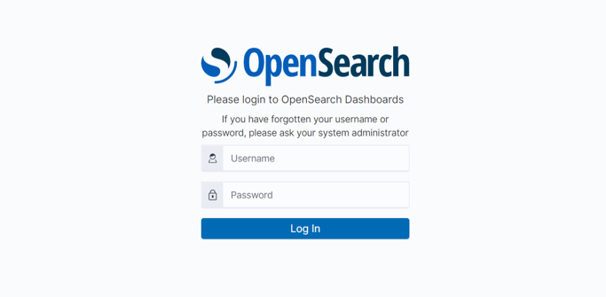
Visualizing Elasticsearch Data
Notes:
Log in using the user credentials you created while creating the OpenSearch Domain.

Slide 12
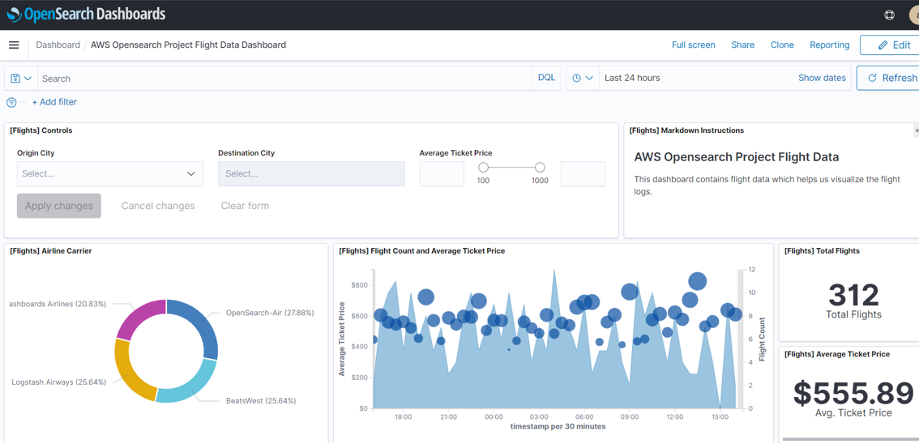
Visualizing Elasticsearch Data

Slide 13
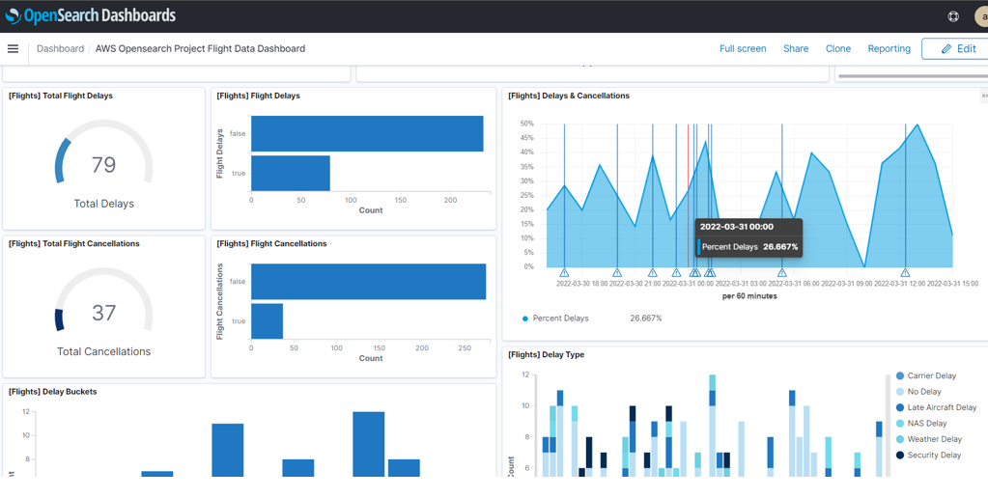
Visualizing Elasticsearch Data

Slide 14
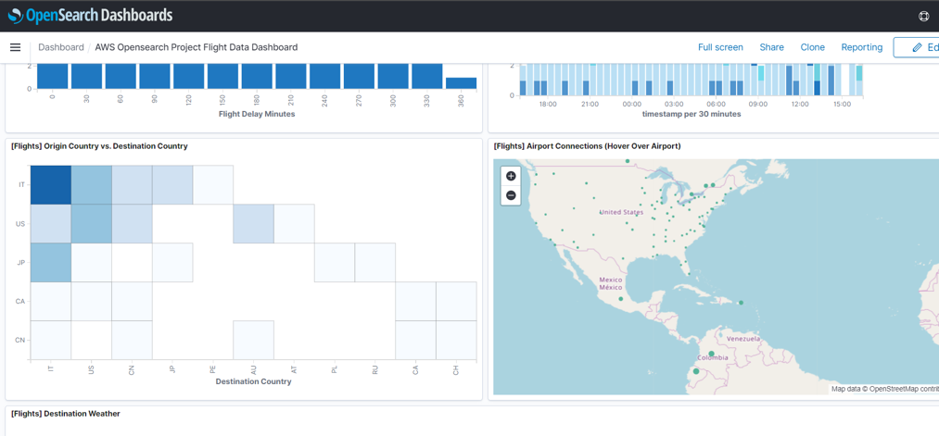
Visualizing Elasticsearch Data

Slide 15
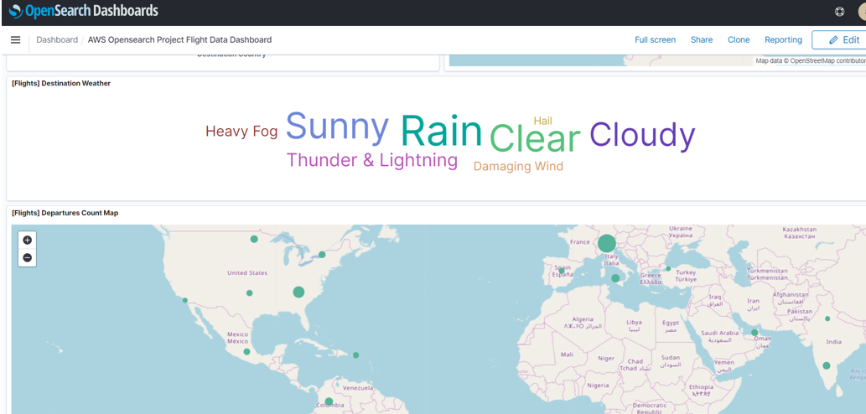
Visualizing Elasticsearch Data

Slide 16
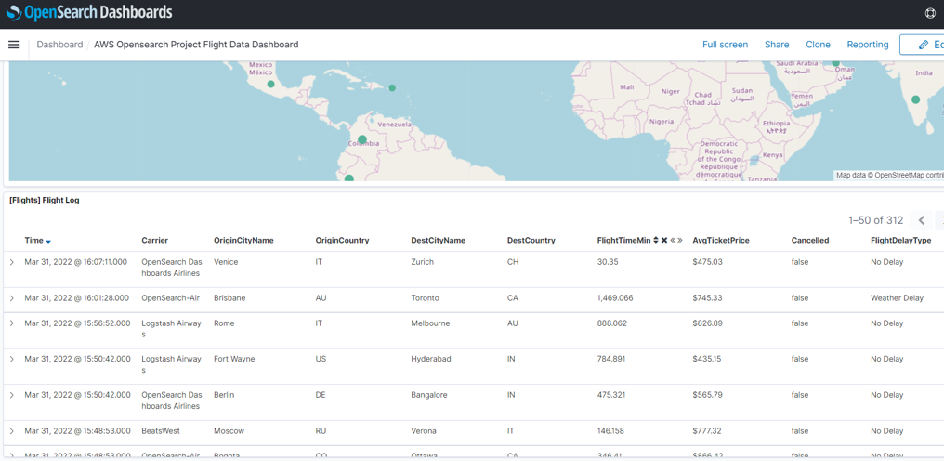
Visualizing Elasticsearch Data

